Slide 1
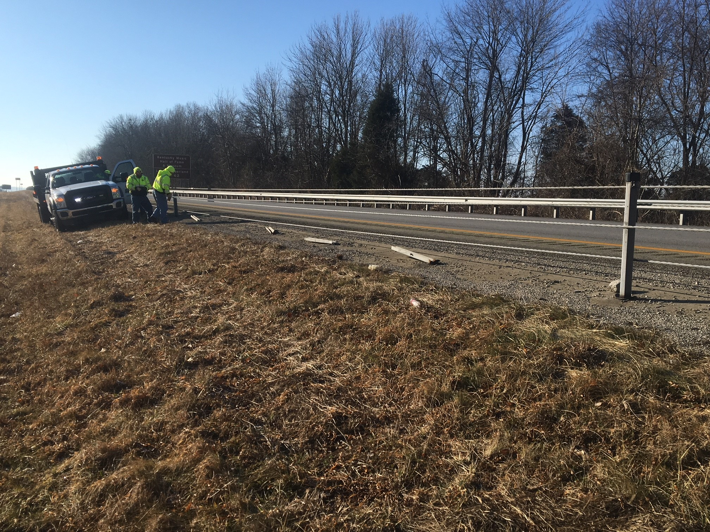
Cable Barrier Repairs
STATE
FORCES
CONTRACT
VS

Slide 2
CONTRACT CONDITIONS
TRAFFIC CONTROL
$50 per shoulder closure
TIME FRAME FOR REPAIRS
5 calendar days of request
Emergency : 24 hrs. of request
Emergency if:
Trinity CASS System – 5 or more post have been disabled
Briefen or Gilbraltor – 8 or more post have been disabled
Notes:
May 2010 Secretary Hancock directed that all cable barrier system maintenance and repairs be accomplished by contract.
This has recently changed.

Slide 3
≈480 POST REPAIRED IN ROCKCASTLE LAST YEAR Prices when purchasing new post
CONTRACT
$250 per post (furnished by Vendor) - $120,000
MAINTENACE
$69 per post (pegs &cap) - $32,600
SAVINGS FOR YEAR Maintenance vs. Contract
$87,400 + Traffic Control
Notes:
Brifen Master Agreement Prices:
Line post = $62.50
3 Pegs = $.90 x 3 = $2.70
Post cap = $3.65
TOTAL = $68.85

Slide 4
≈480 POST REPAIRED IN ROCKCASTLE LAST YEAR Prices when using reclaimed post
MAINTENACE
$6 per post (pegs & caps) - $2,900
SAVINGS FOR YEAR Maintenance vs. Contract
$117,100 + Traffic Control
Notes:
-We have taken down 4.5 miles of cable rail due to I75 widening project.
-Will soon take down 9 more miles, therefore large inventory of reclaimed post will be available.

Slide 5
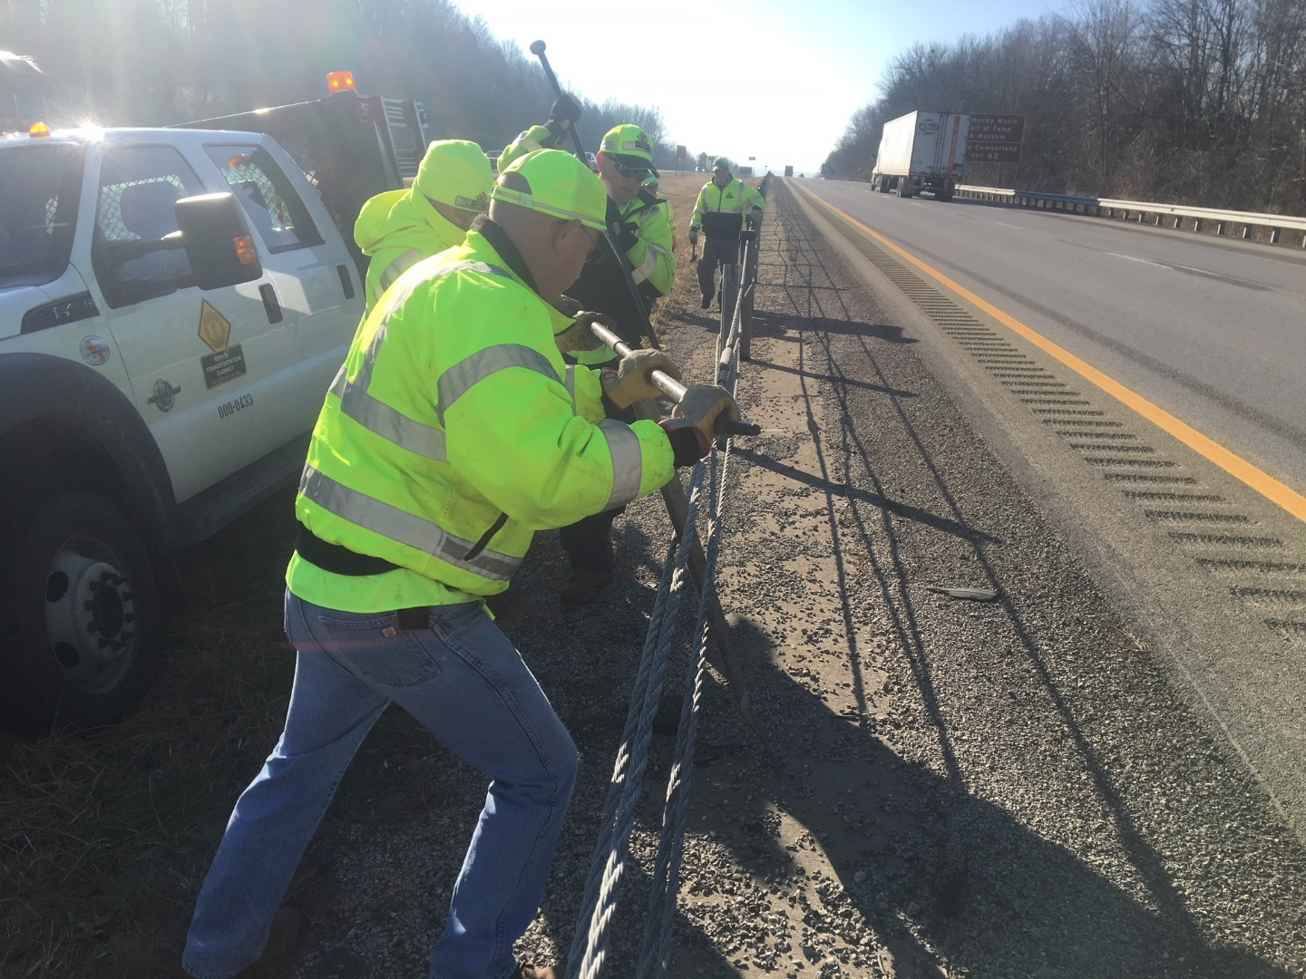
Brifen OMS Charge Codes
M47020 – POST CAPS
M47031 – POST
M47036 – PEGS
TOOLS
Spud Bar
Spreader Bar
Notes:
Maintenance can not install anchor post due to the tension at the end of a line.
We still have contractors do all repairs except replacing line post.

Slide 6
QUESTIONS?

